Slide 1
RESBUD SE
we build to connect people
August 2021

Slide 2
RESBUD SE – We build to connect people
We build
to connect people
Our mission is to increase the value of the companies that comprise the holding through monitoring and coordinating their development. We want to generate profits for our shareholders and create added value for the economy, the society and the environment.
Therefore, we constantly develop our experience and knowledge, following the highest standards and best practices in the construction industry. By supporting the construction of modern infrastructure facilities, we want to improve the quality of life – today and tomorrow.
RESBUD SE – we build to connect people

Slide 3
About RESBUD SE
RESBUD SE is a modern, dynamically growing European holding company present on the construction, power and civil engineering markets, and also dealing with manufacturing, logistics and delivery of materials and equipment for the construction and power sectors. RESBUD SE has been listed on the Warsaw Stock Exchange since September 2007. It combines a modern approach to business with a 70-year tradition in the construction industry.
In RESBUD SE investment portfolio, there are companies (Energokomplekt OOO, Conpol sp. z o.o. and Uniwersim sp. z o.o.) that specialize first and foremost in: civil engineering, construction works, construction of concrete structures, construction of civil road and railway engineering structures, production of asphalt mixtures and concrete and delivery of materials and equipment to large infrastructure projects, including equipment for construction and modernization of power facilities.
70years
since
2007
tradition in the construction
industry
listed on the Warsaw Stock Exchange
over
26mln EUR
Central and Western
Europe
share capital of the Company
contracts carried out
RESBUD SE – we build to connect people

Slide 4
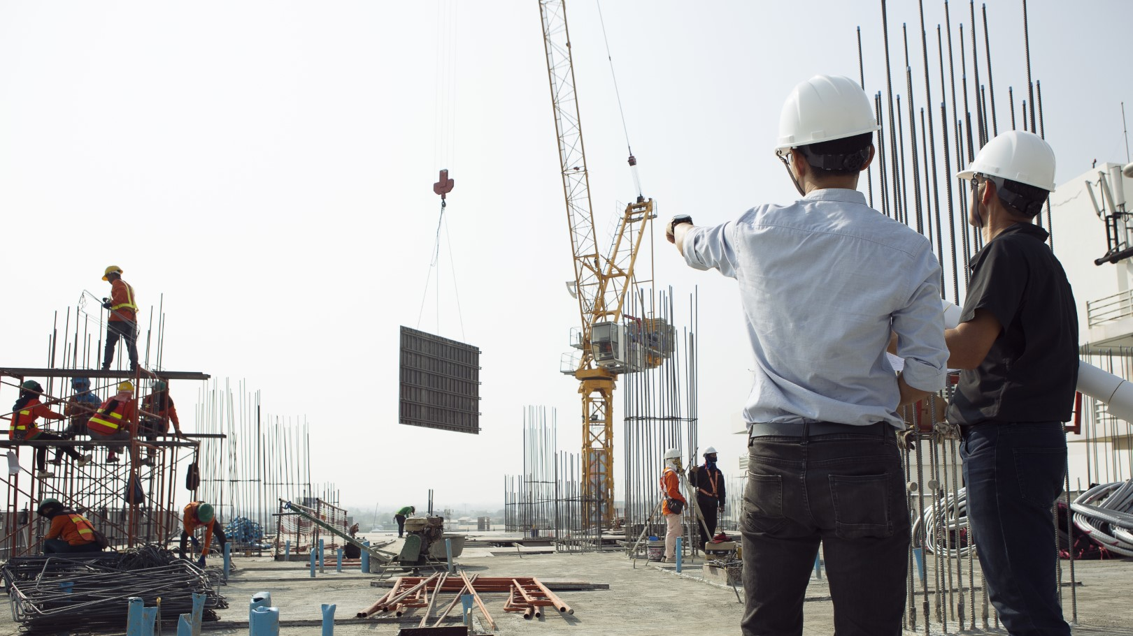
RESBUD – where we come from
In 2019, following a change of the majority shareholder, RESBUD changed its business model and strategy. The company launched the process of transforming into a modern, dynamically growing holding company, operating in various segments of the construction and civil engineering markets, and dealing also with manufacturing, logistics and delivery of materials for the construction sector.
Over 1,100 people were involved in overseas projects, that is a third of RESBUD’s employees. The revenues from overseas construction contracts accounted for nearly 30% of the company’s total sales value. At that time, the company delivered over 50 construction projects.
RESBUD established its unquestioned position of the construction industry leader in south-east Poland.
1960s
After 2000s
1950s
The company started its expansion abroad. RESBUD’s engineers and employees worked in several European countries, including the Federal Republic of Germany, the German Democratic Republic, Czechoslovakia, Hungary, Belgium, and also on other continents, e.g., Africa.
1980s / 1990s
On 27 September 2007 RESBUD announced its debut on the Warsaw Stock Exchange. RESBUD was a general contractor of numerous, recognized by industry expert's construction projects all over the country. Long experience and many projects delivered over the years have earned RESBUD a reputation of being a reliable and trustworthy first-choice partner.
Today
RESBUD SE – we build to connect people

Slide 5
RESBUD SE
INCREASE IN THE SHARE CAPITAL OF RESBUD SE
9th of March 2021 The Estonian Commercial Register approved an increase of RESBUD SE share capital by over EUR 24 mln to over EUR 26 mln and registered the related amendments to the Company’s Articles of Association.
It is the finalization of the process of acquiring majority shares in Uniwersim sp. z o.o., Conpol sp. z o.o. and Energokomplekt OOO, thanks to the private subscription of over 218 million new RESBUD SE shares.
The decision of the Estonian Commercial Register indicates that from March 9, 2021:
the share capital of RESBUD SE is 26 028 229 EUR (previously it was 1,991 milion EUR);
the total number of votes and non-par value shares is 236 620 263.
RESBUD SE – we build to connect people

Slide 6
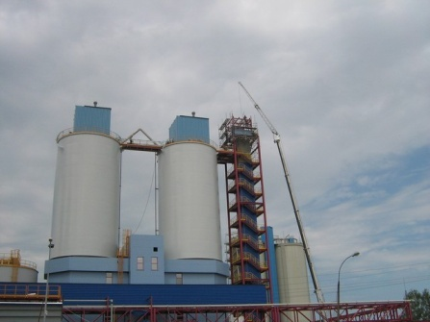
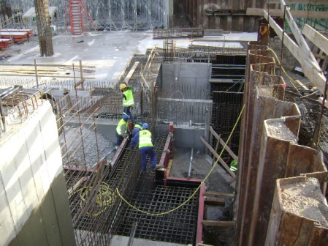
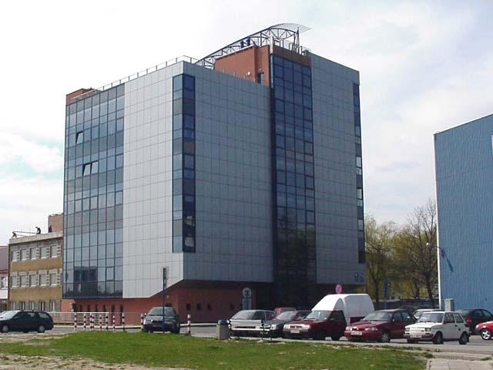
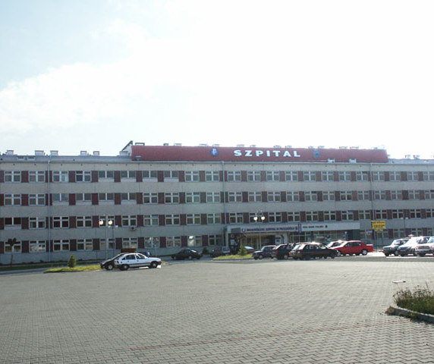
RESBUD – what we did?
RESBUD – PAST PROJECTS
2
3
4
execution of construction works related to the second stage of expansion of the so-fermenting hall with infrastructure in Browar Okocim in Brzesko - for Carlsberg Polska;
construction works for a power plant Pątnów-Adamów-Konin;
construction of the truck's assembly factory “Man” in Niepołomice;
construction of a multifunctional National Stadium in Warsaw, together with accompanying infrastructure;
build-up, extension and modernization of the "P" building of the Rzeszów University of Technology;
construction of a Voivodship Hospital in Przemyśl.
5
6
The above is to show only some of the numerous ventures undertaken by RESBUD, Energokomplekt, Conpol and Uniwersim
RESBUD SE – we build to connect people

Slide 7
RESBUD SE – holding structure
OPERATING STRUCTURE - TODAY
RESBUD SE
POLAND
RUSSIA
Conpol sp. z o.o
POLAND
Energokomplekt OOO
contractor in the construction of civil engineering structures, on road and railways.
contractor in energy and construction projects and a trading company based in Ekaterinburg, which is a comprehensive operator of supplies of equipment, materials, construction chemicals and specialized devices for large energy, hydraulic engineering and infrastructure investments.
Uniwersim sp. z o.o.
producer of bituminous masses and high-quality concretes.
RESBUD SE – we build to connect people

Slide 8
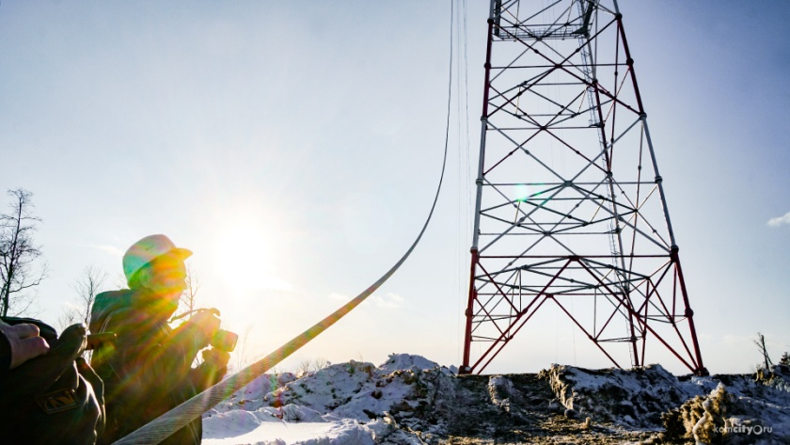
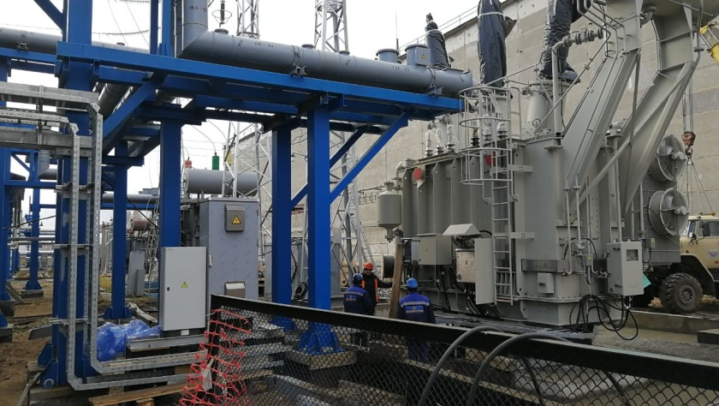
Our companies
ENERGOKOMPLEKT:
a trading company based in Yekaterinburg and a general contractor in energy and construction investments and a comprehensive operator of hardware, materials, construction chemicals and specialized devices for large energy, hydraulic engineering and infrastructure investments;
the basis of the company's operations are contracts for the comprehensive supply of materials, chemicals and equipment for specific construction projects – in the years 2015-2019, Energokomplekt OOO completed such contracts for the amount of over 15 billion rubles;
clients include the largest construction companies in Russia and several countries of the Commonwealth of Independent States;
operates on several foreign markets - from Poland and Estonia to the Far East.
The company offers:
comprehensive delivery of equipment and materials for the needs of contractors involved in the construction of all kinds of infrastructural facilities;
logistics services related to the delivery of materials to any location in the world, customs clearance and storage of products, as well as hiring suppliers tailored to the needs and requirements of clients;
design and consulting services, including certification of new materials and equipment, coordination of alternative technologies, amendments to design specifications and cost estimates, obtaining approvals necessary to launch construction works;
promotional support of European products to the Russian market through well-established logistical channels.
www.ekekb.ru
RESBUD SE – we build to connect people

Slide 9
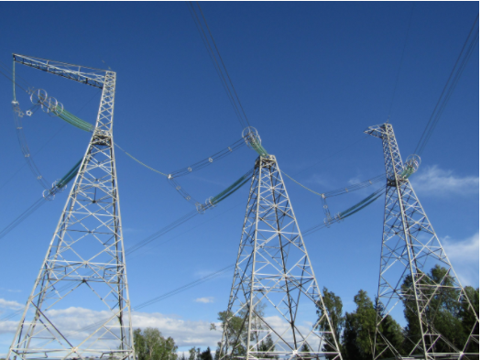
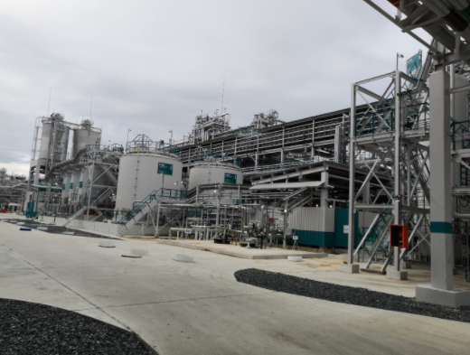
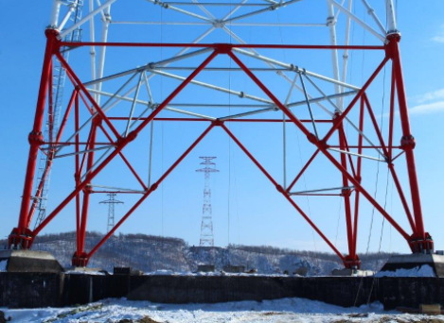
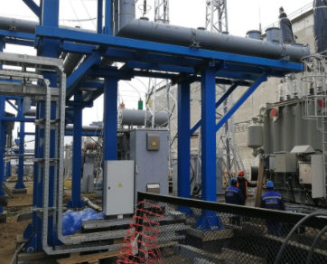
Energokomplekt OOO – our projects
OHTL 220 kV Komsomolskaya-Selikhino for Branch of UES FGS PAO (JSC) – Main Power Networks of the East (MES Vostoka)
Construction of a new facility for the production of DOTP wih a capacity of 100 thousand tons per annum on the premises of Sibur-Khimprom АО (JSC)
Construction of OHTL 220 kV Selikhino-Vanino for Branch of UES FGS PAO (JSC) – Main Power Networks of the East (MES Vostoka)
Reconstruction of MSDS-220 (step-down substation) on the premises of Gazpromneft-ONPZ АО (JSC)
The above is to show only some of the numerous ventures undertaken by RESBUD, Energokomplekt, Conpol and Uniwersim
RESBUD SE – we build to connect people

Slide 10
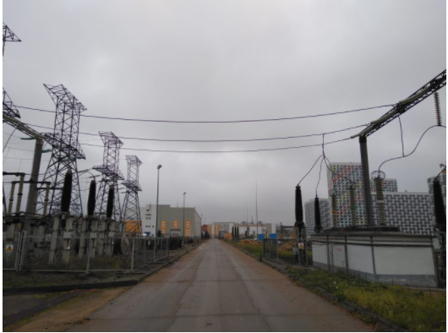
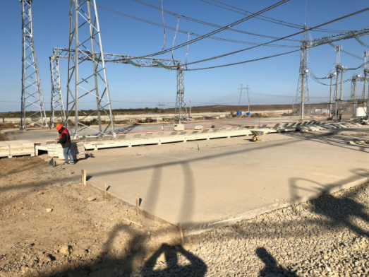
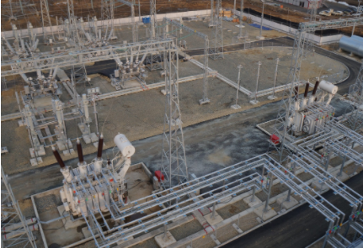
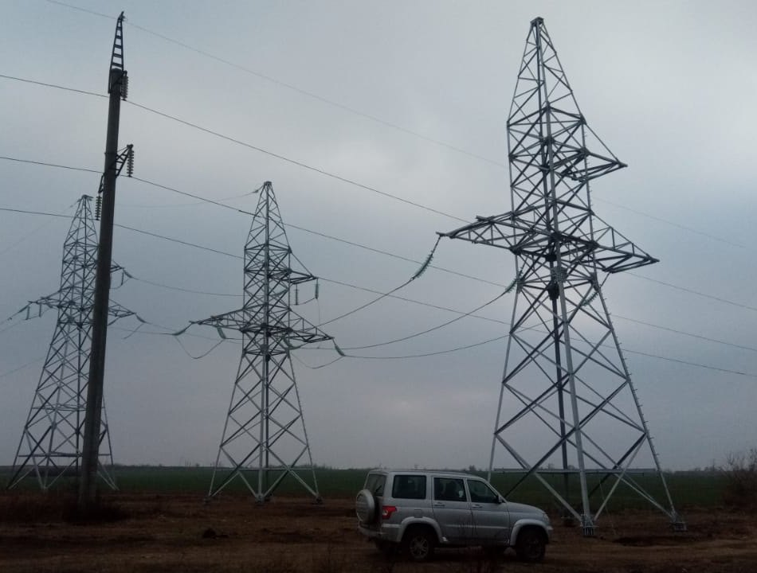
Energokomplekt OOO – our projects
Comprehensive upgrading and retooling of Substation 500/220/110 kV Beskudnikovo for Branch of UES FGS PAO (JSC) – Main Power Networks of the Centre (MES Centra)
OHTL 500 kV Rostovskaya NPP – Tikhoretskaya No. 2 with the expansion of Substation 500 kV Tikhoretskaya. (L=357 279 km) for Branch of UES FGS PAO (JSC) – Main Power Networks of the South (MES Yuga)
Expansion of Substation 220 kV Vanino for Branch of UES FGS PAO (JSC) – Main Power Networks of the East (MES Vostoka)
Delivery of materials for the construction of 110 kV power lines during the execution of works to connect the 110 kV PS of the Kamenskaya and Sulinskaya wind farms to the electric networks
The above is to show only some of the numerous ventures undertaken by RESBUD, Energokomplekt, Conpol and Uniwersim
RESBUD SE – we build to connect people

Slide 11
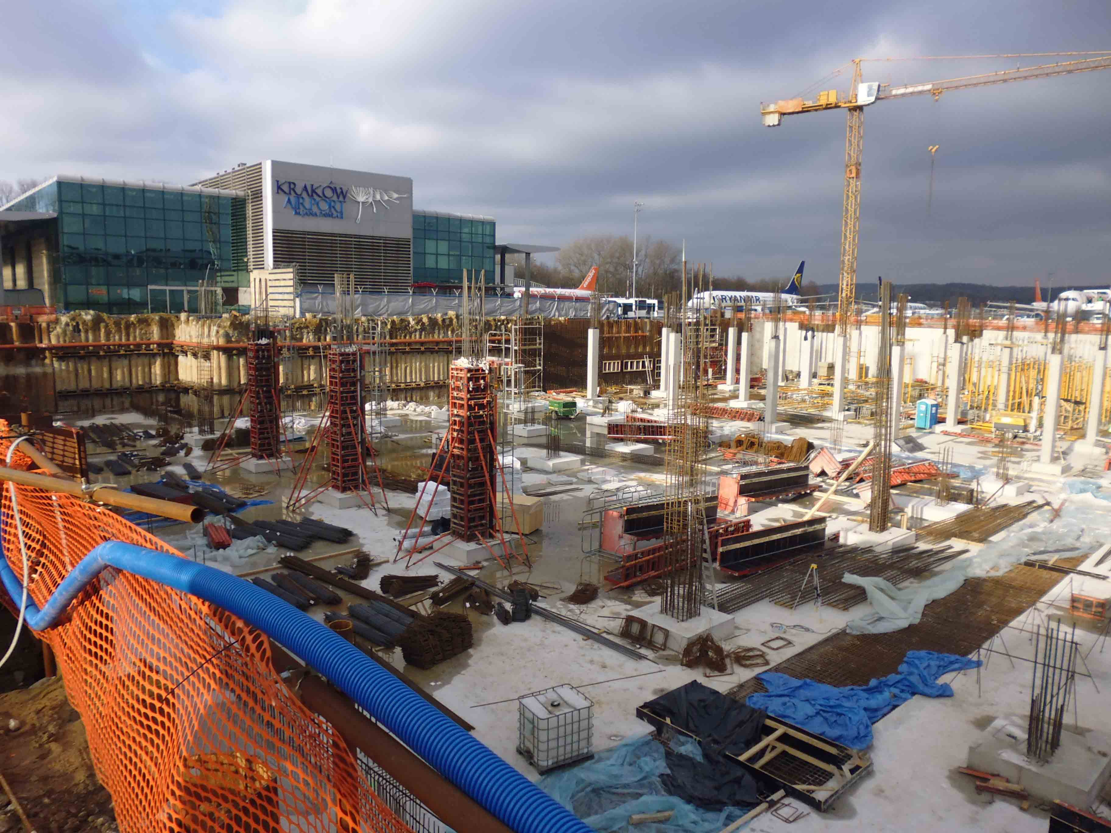
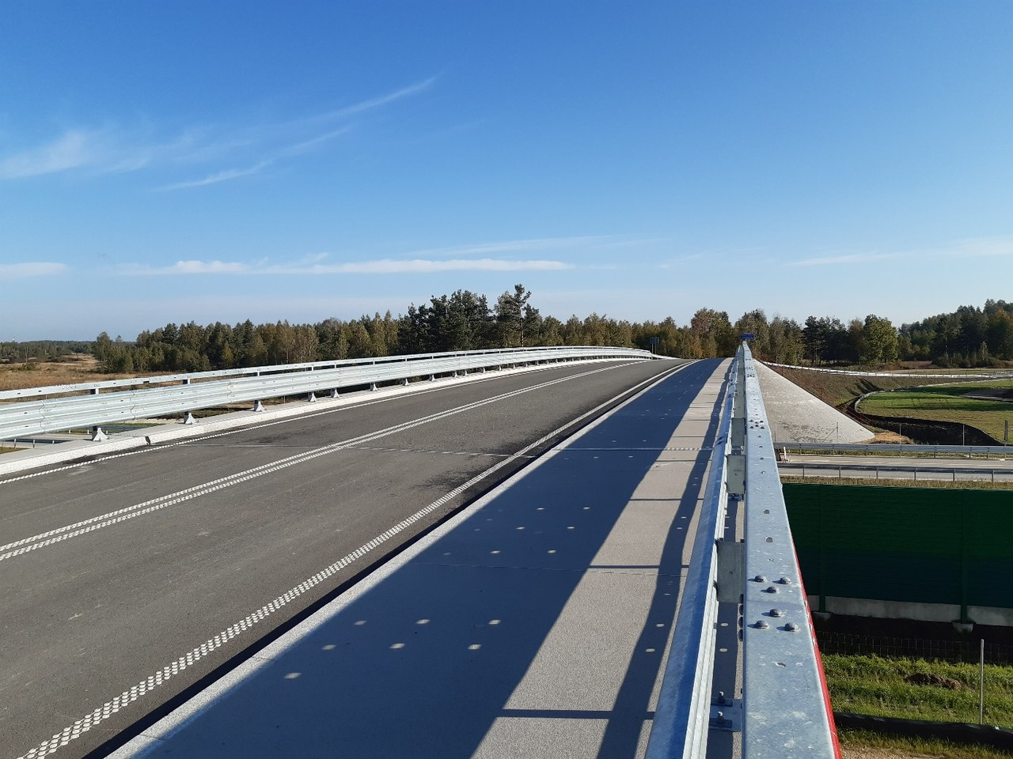
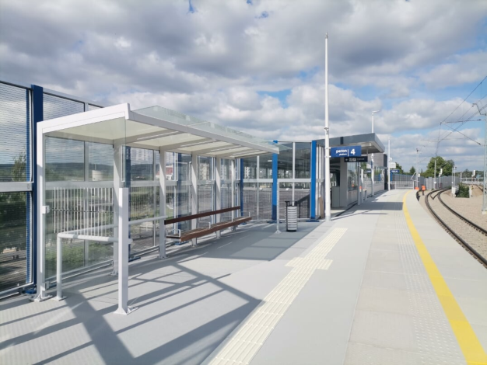
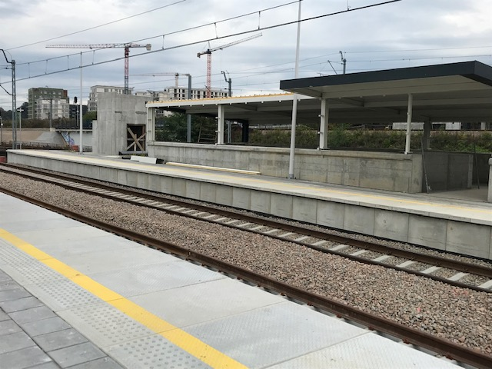
Our companies
CONPOL:
extensive competences in the field of:
www.conpol.pl
civil engineering
energy construction
concrete and asphalt
production
currently is successfully operating on the Polish market, participating as a contractor in the field of cubature, engineering and road construction;
gained vast experience in the construction industry on eastern markets. The projects implemented there, such as the expansion of terminal D at the BORYSPOL airport in Kiev, allowed to develop a modern form of the company's activity and to attract a number of specialized companies from Lithuania, Latvia, Belarus and Ukraine for cooperation;
member of the Polish chamber of Construction Industry and Trade, registration number 801;
the scope of the company's activity also includes the production of concrete according to customer preferences, for the construction of bridges and viaducts.
RESBUD SE – we build to connect people

Slide 12
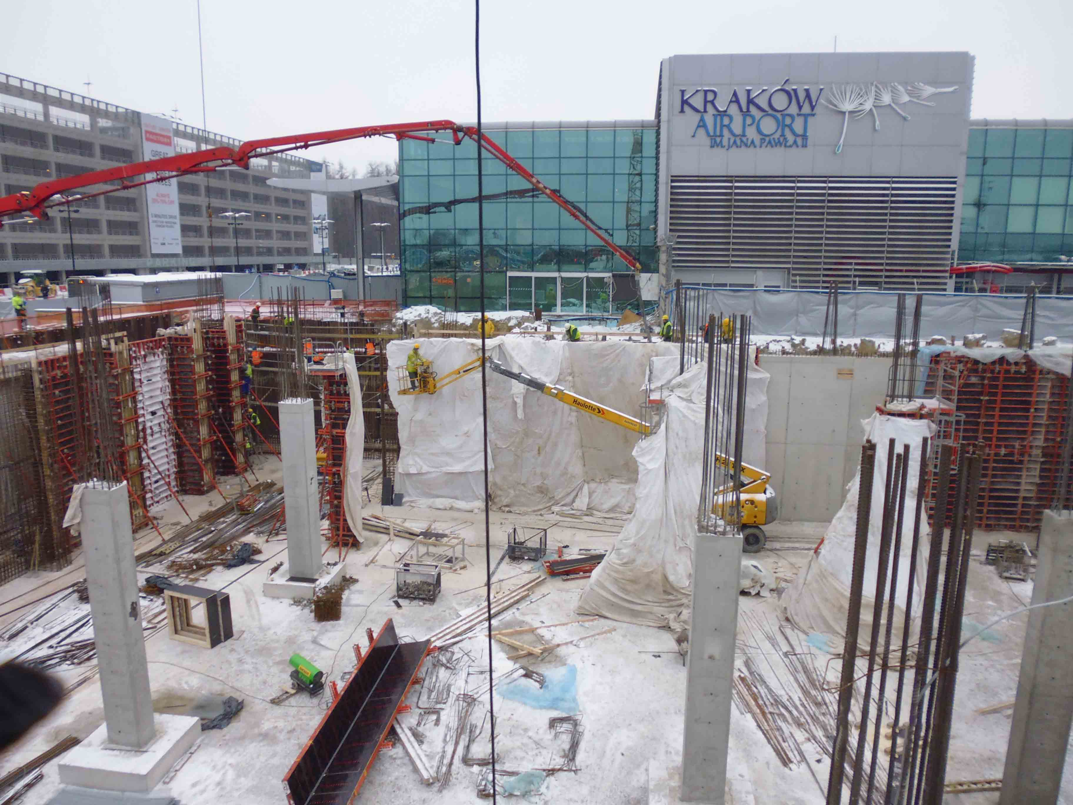
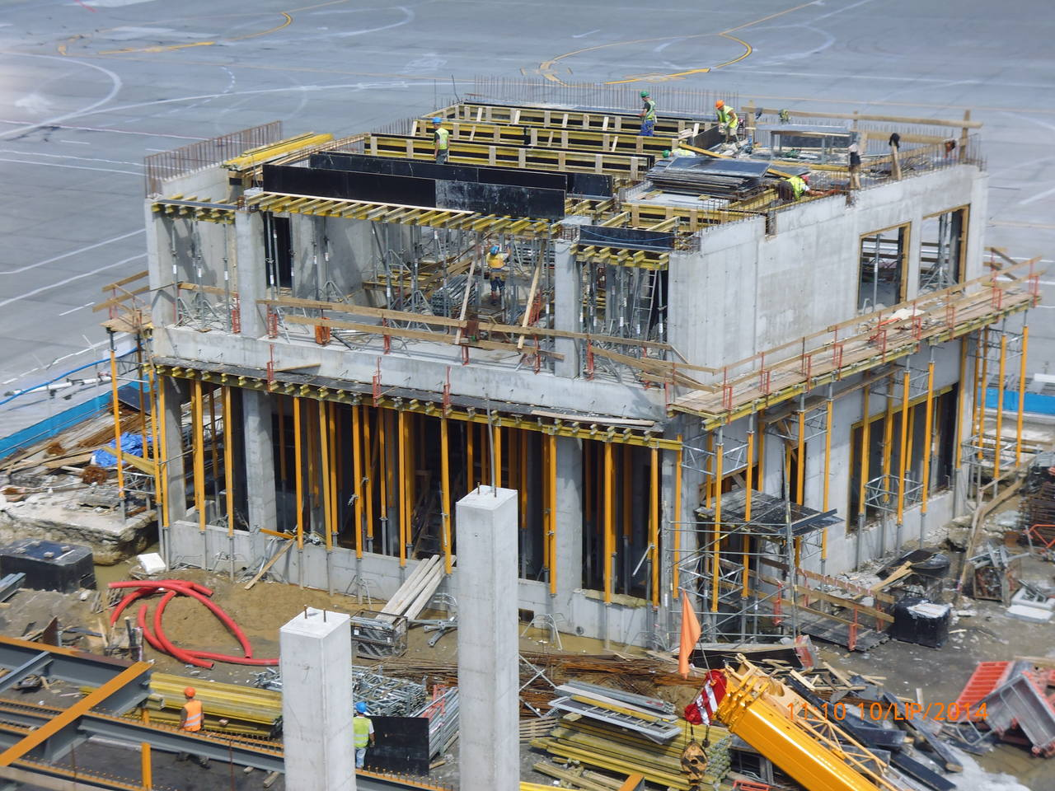
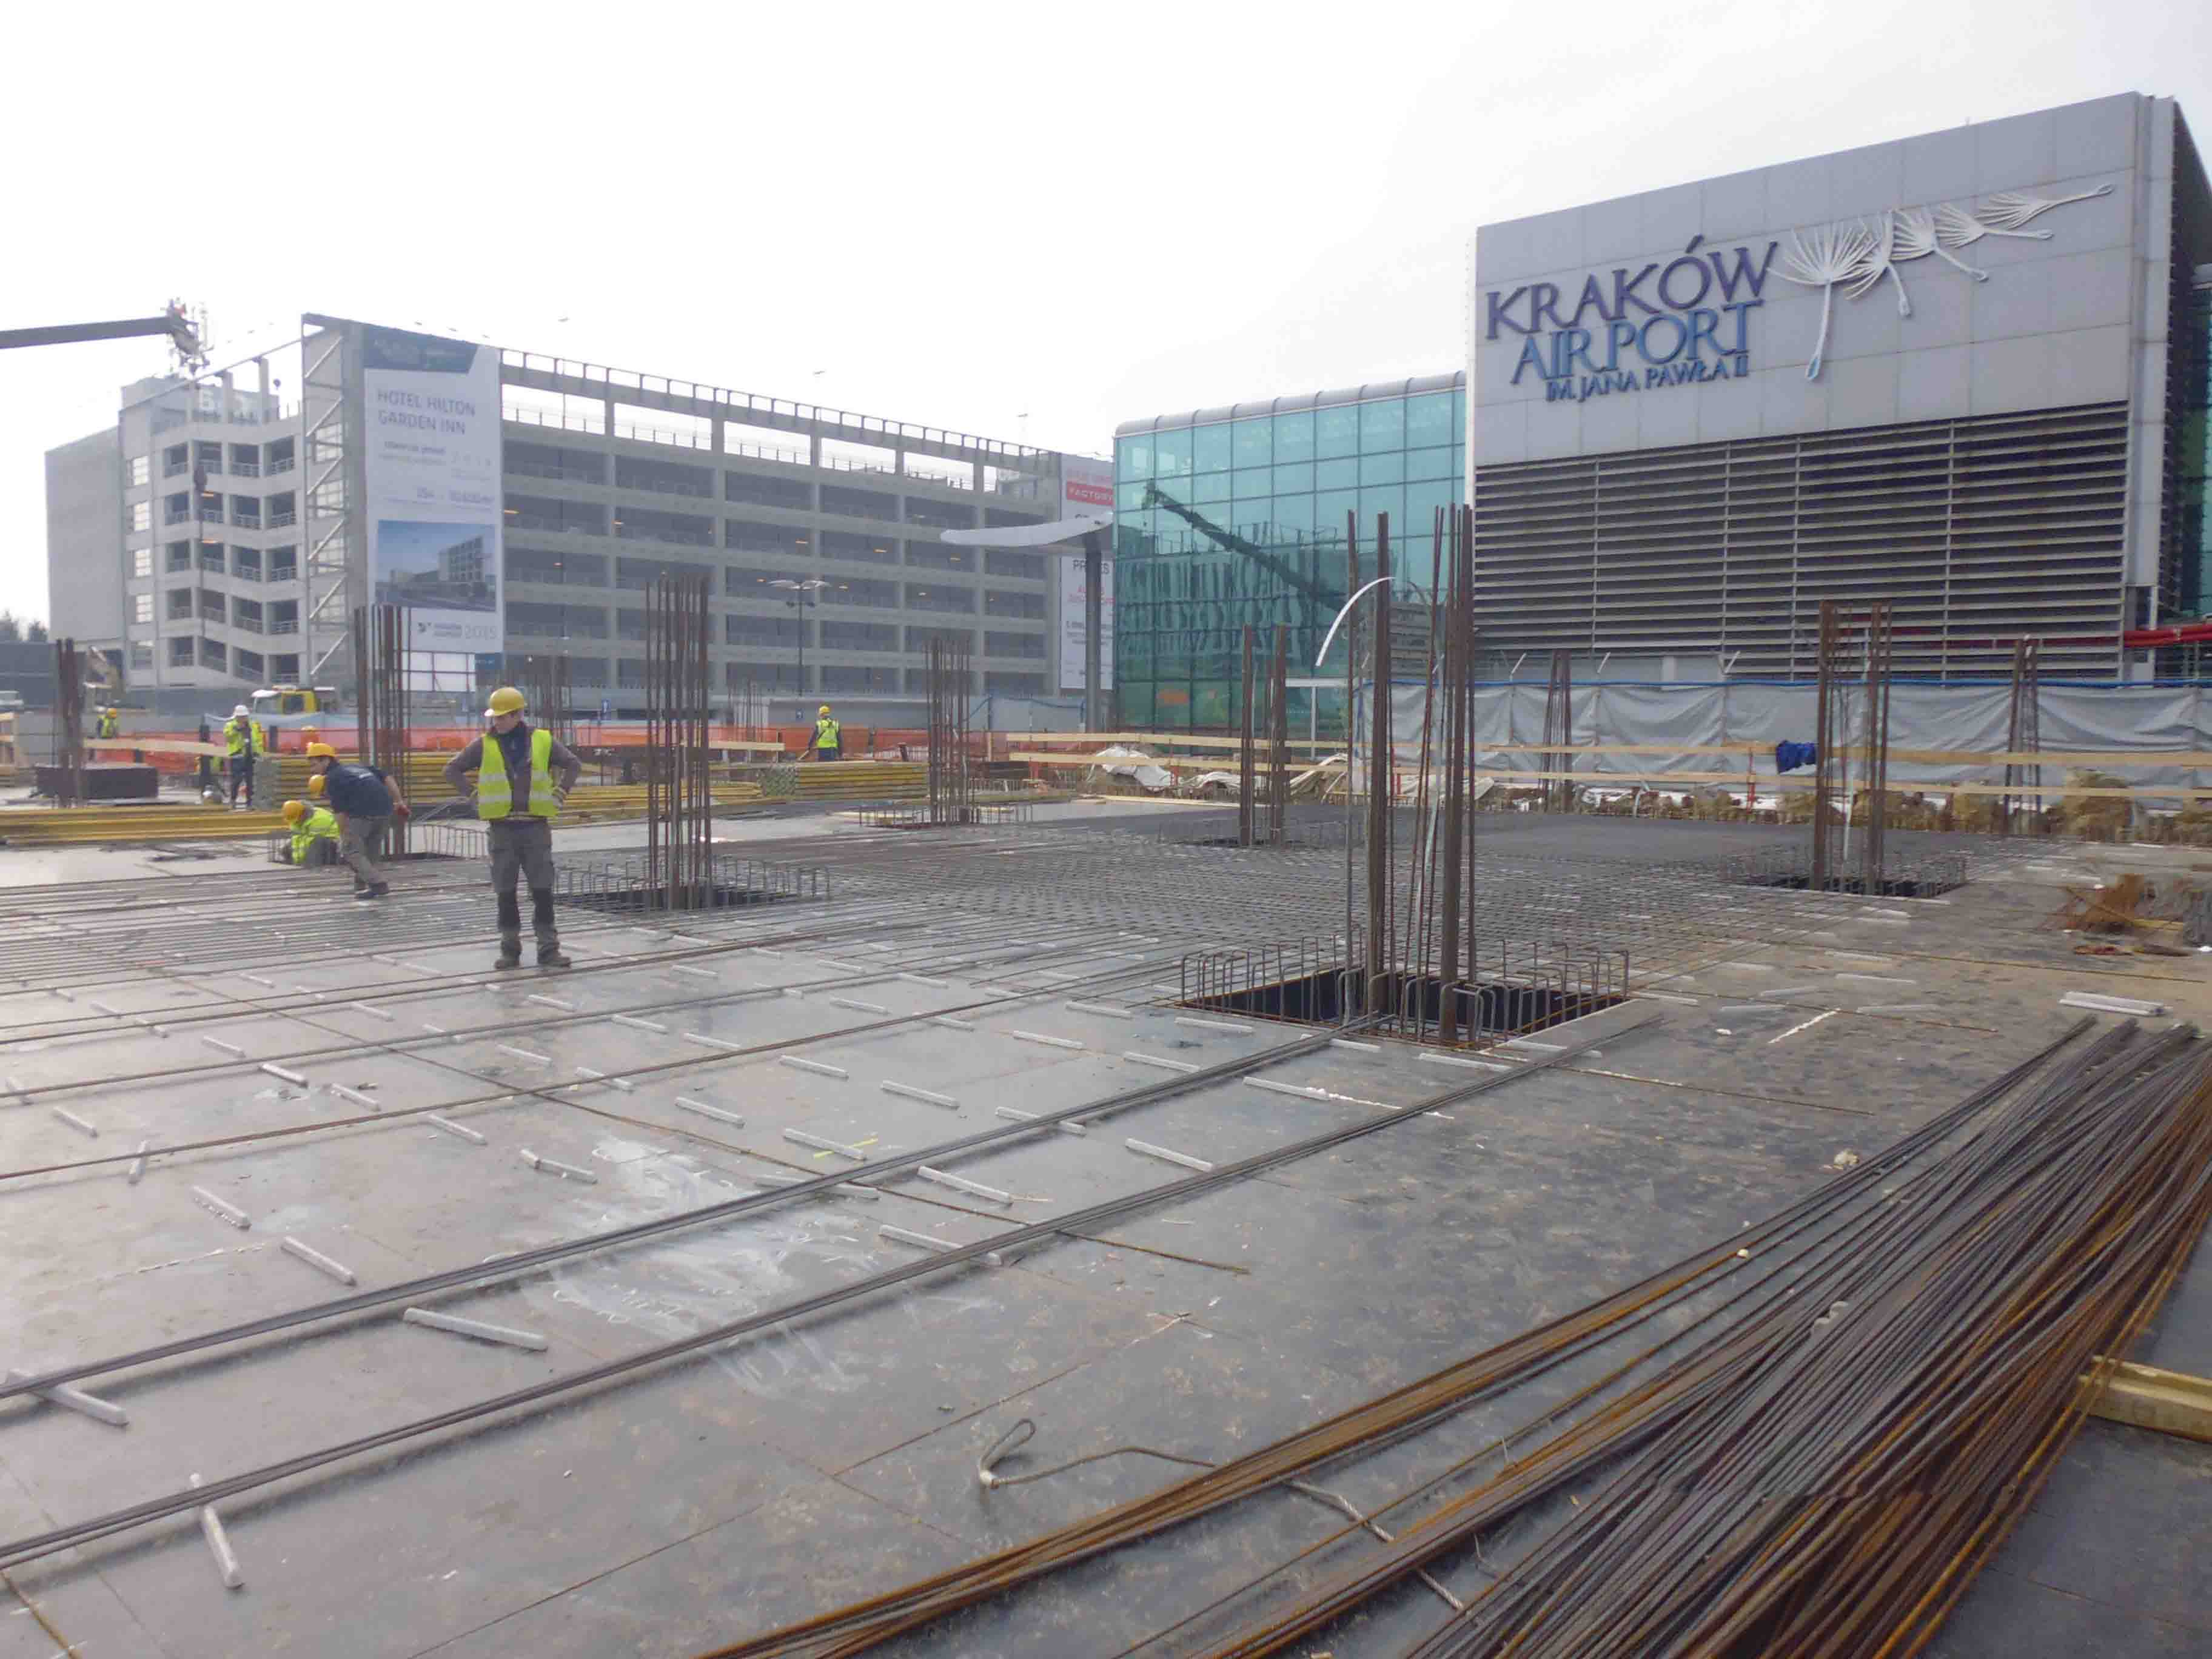
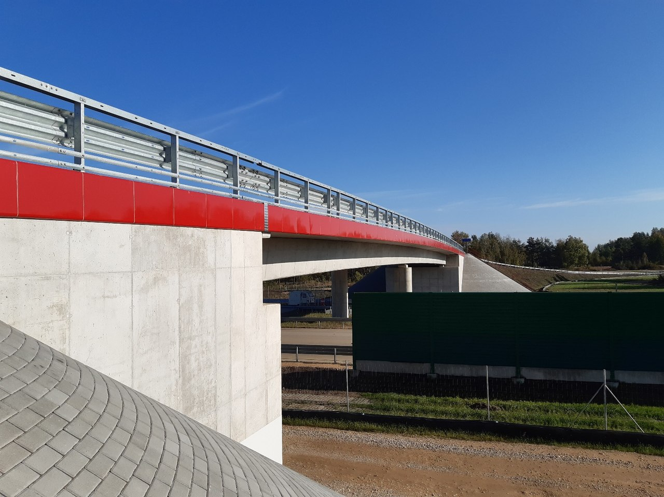
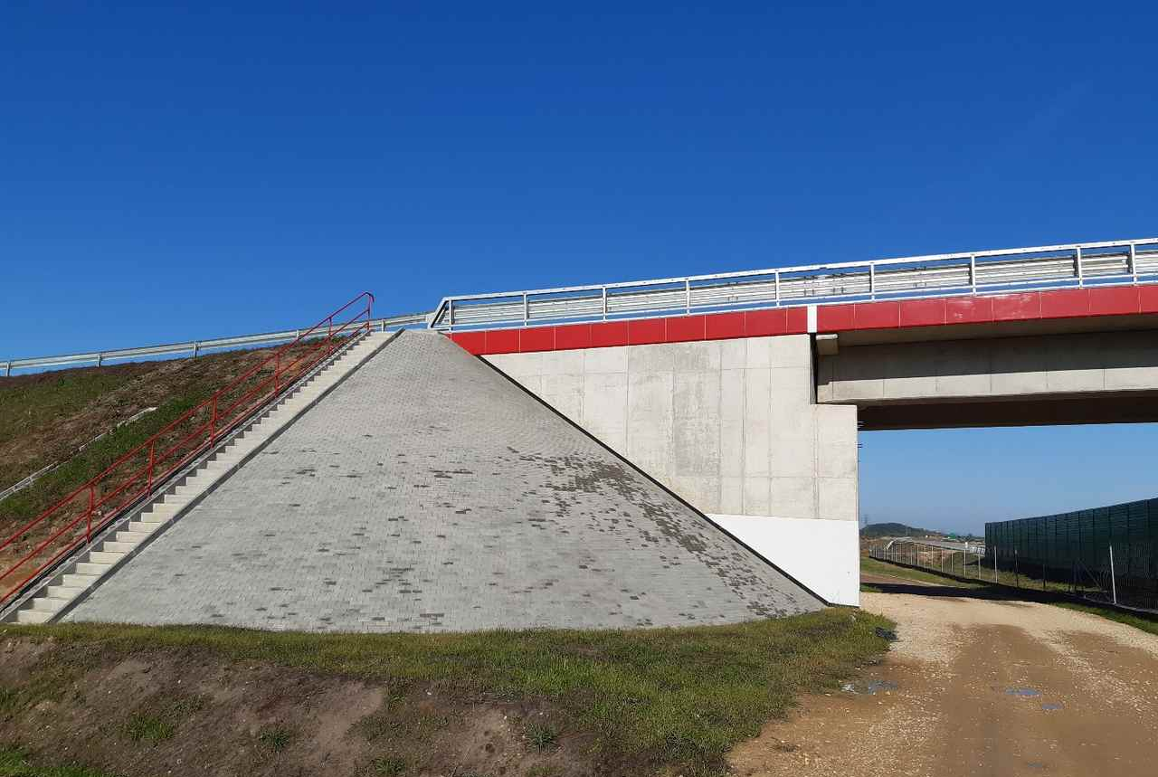
Conpol sp. z o.o. – our projects
Execution of construction works at the John Paul II Krakow-Balice International Airport
Construction of concrete and reinforced concrete structures on the Tuszyn-Pyrzowice section,
A1 motorway, section G
The above is to show only some of the numerous ventures undertaken by RESBUD, Energokomplekt, Conpol and Uniwersim
RESBUD SE – we build to connect people

Slide 13
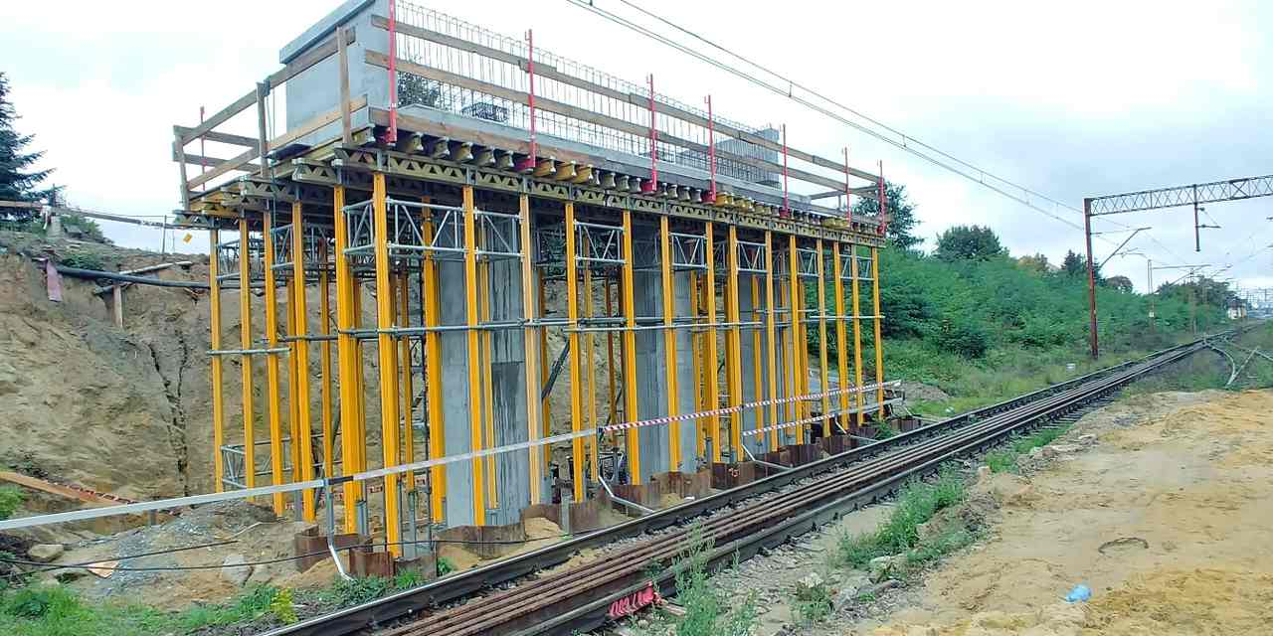
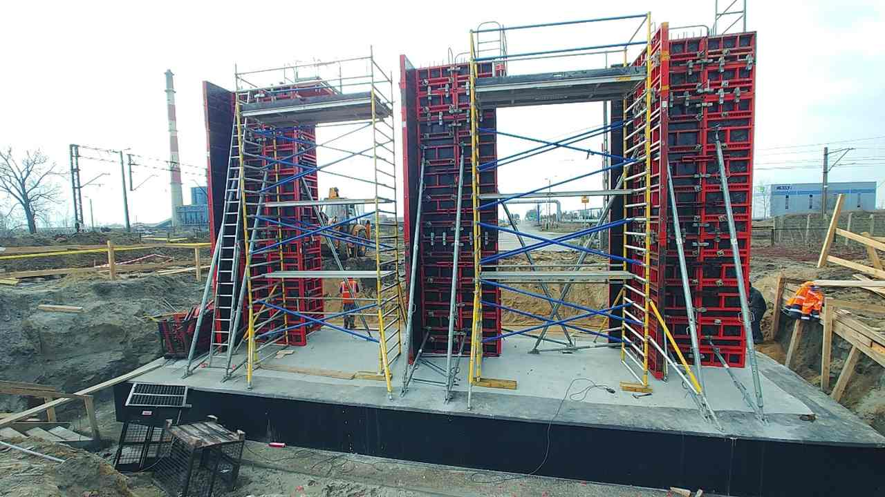
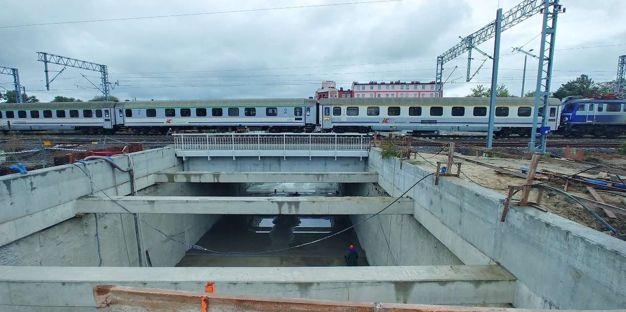
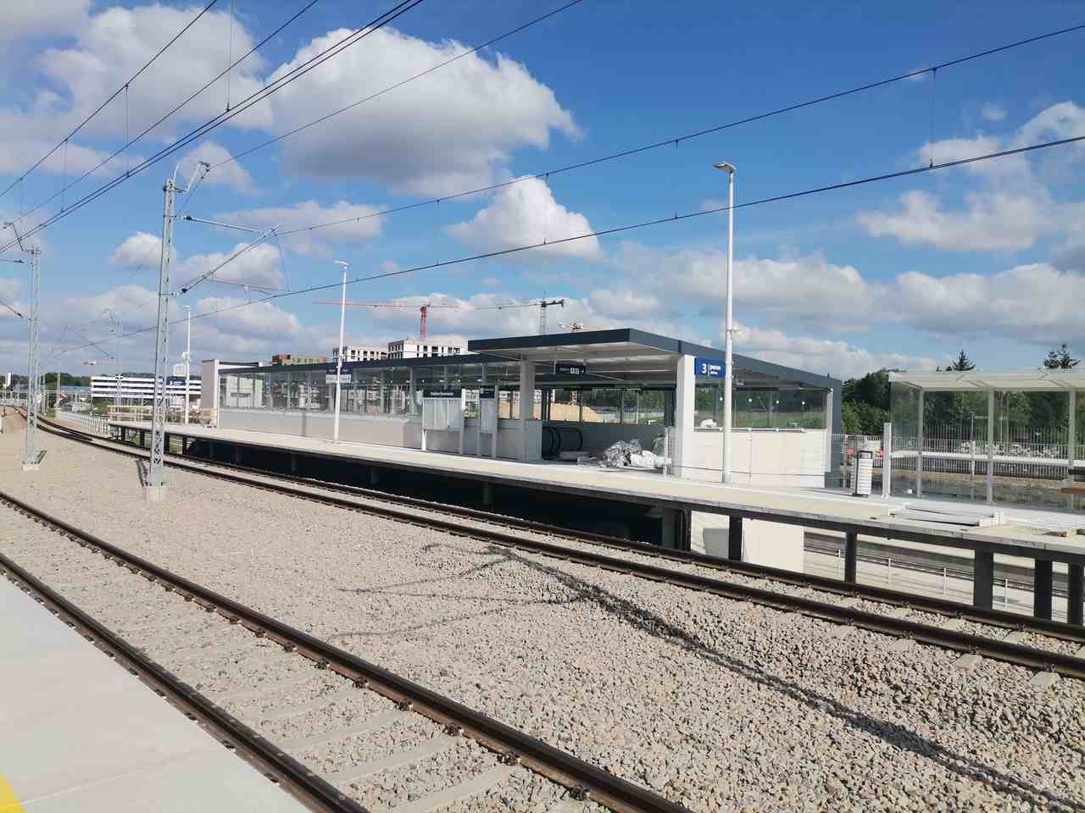
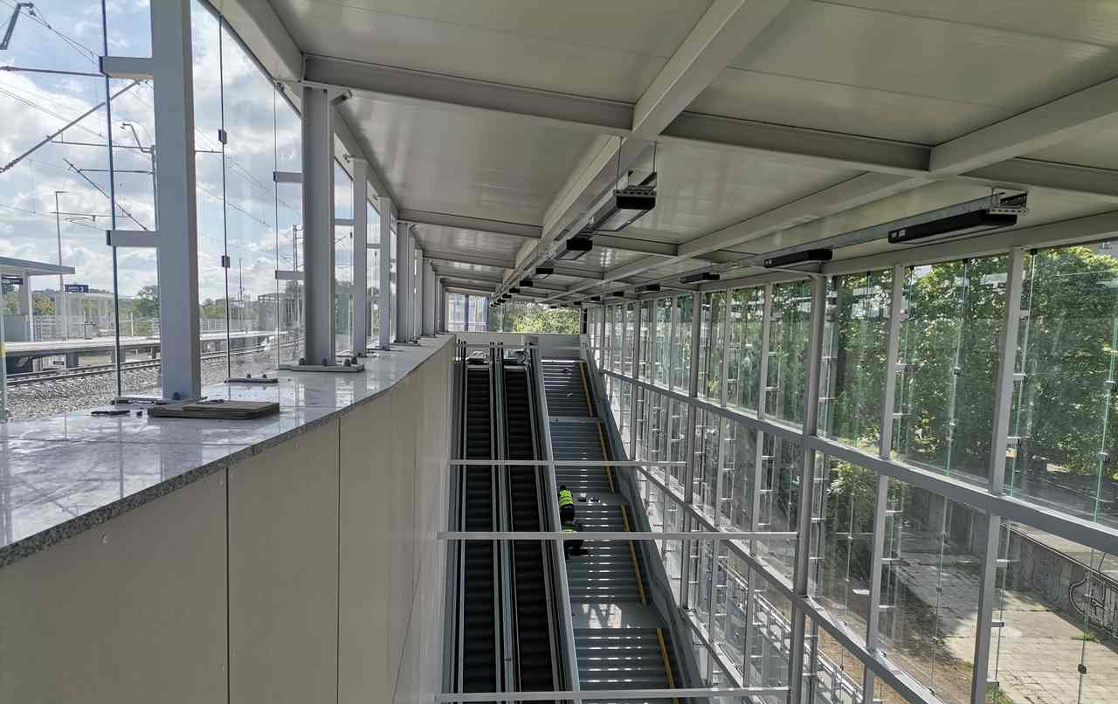
Conpol sp. z o.o. – our projects
Reconstruction of track systems with accompanying infrastructure on the E59 railway line, Leszno-Czempiń section
Execution of construction works on the E30 Kraków Mydlniki - Kraków Główny Towarowy section
The above is to show only some of the numerous ventures undertaken by RESBUD, Energokomplekt, Conpol and Uniwersim
RESBUD SE – we build to connect people

Slide 14
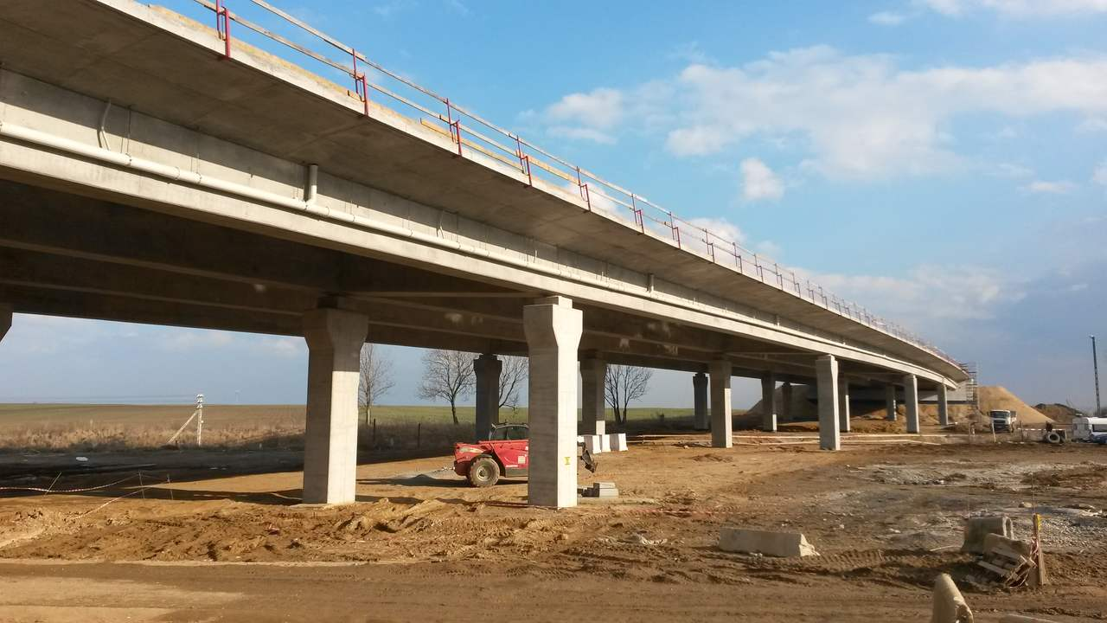
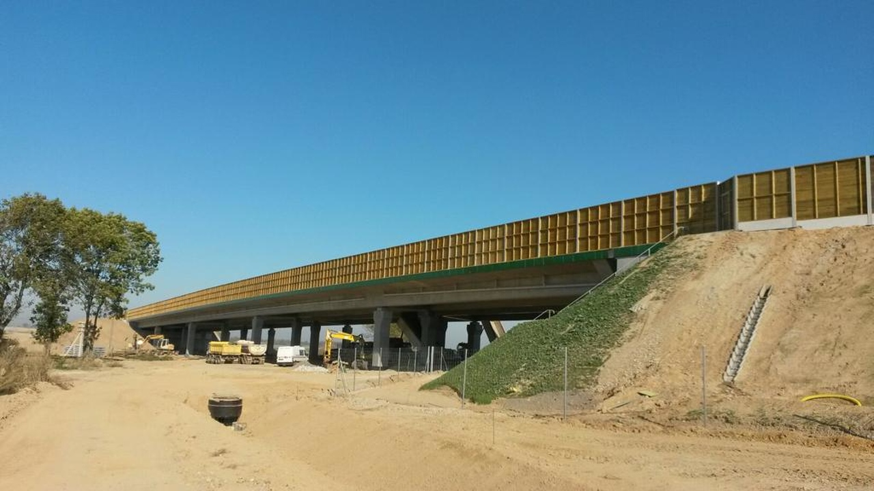
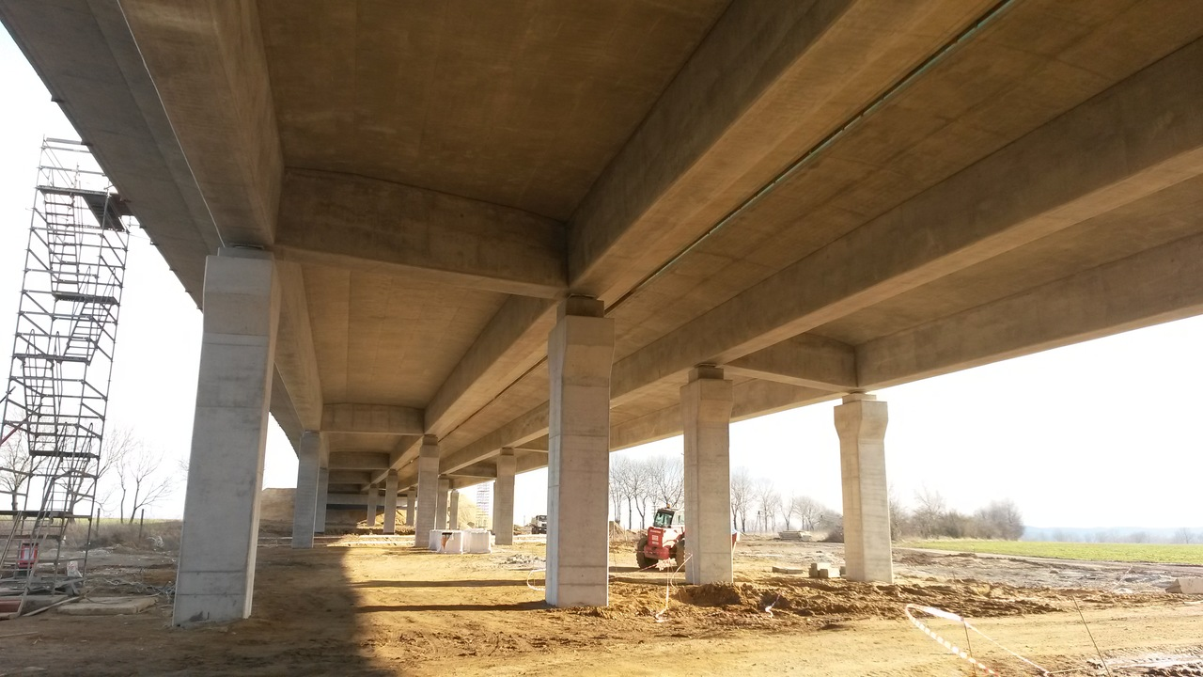
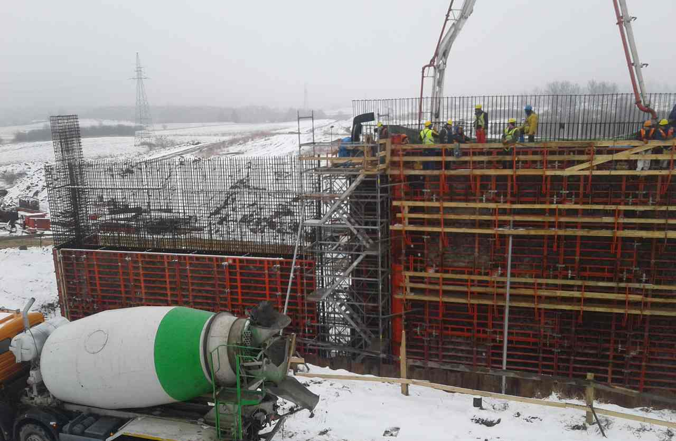
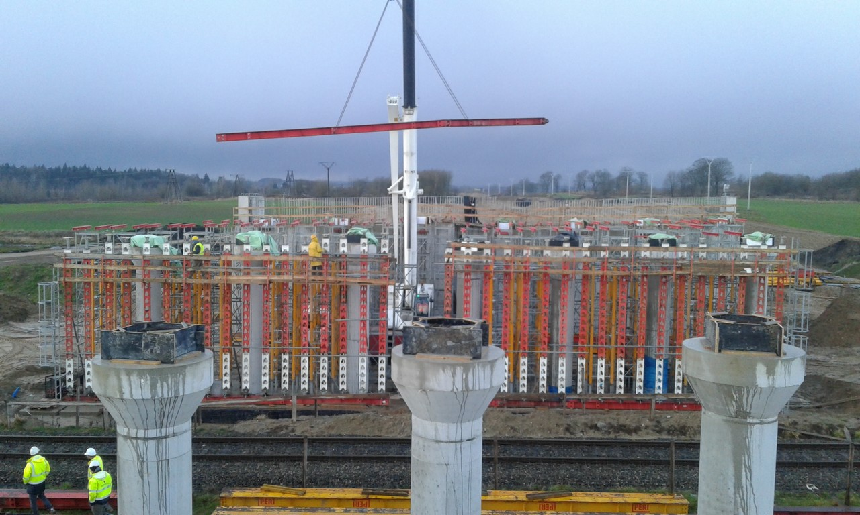
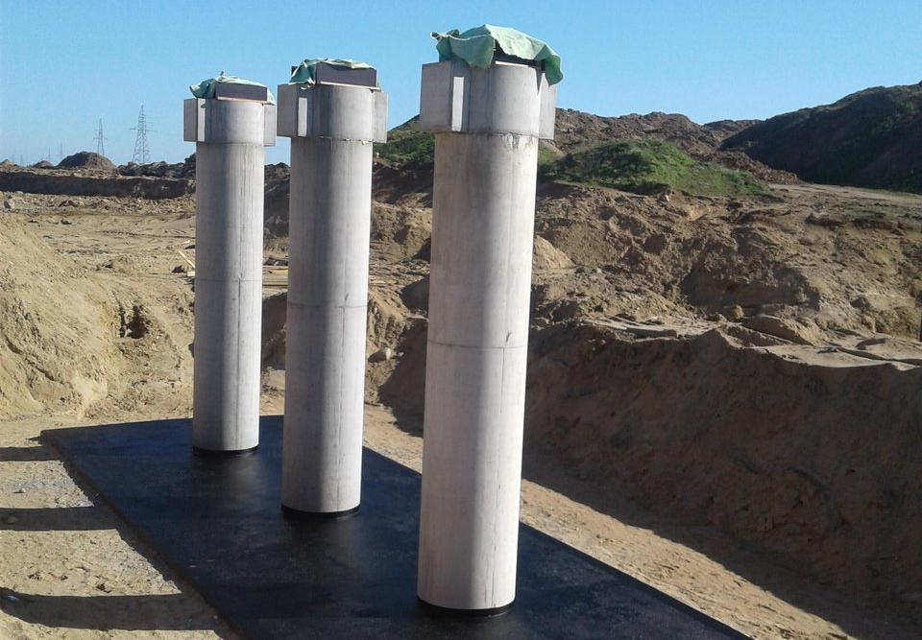
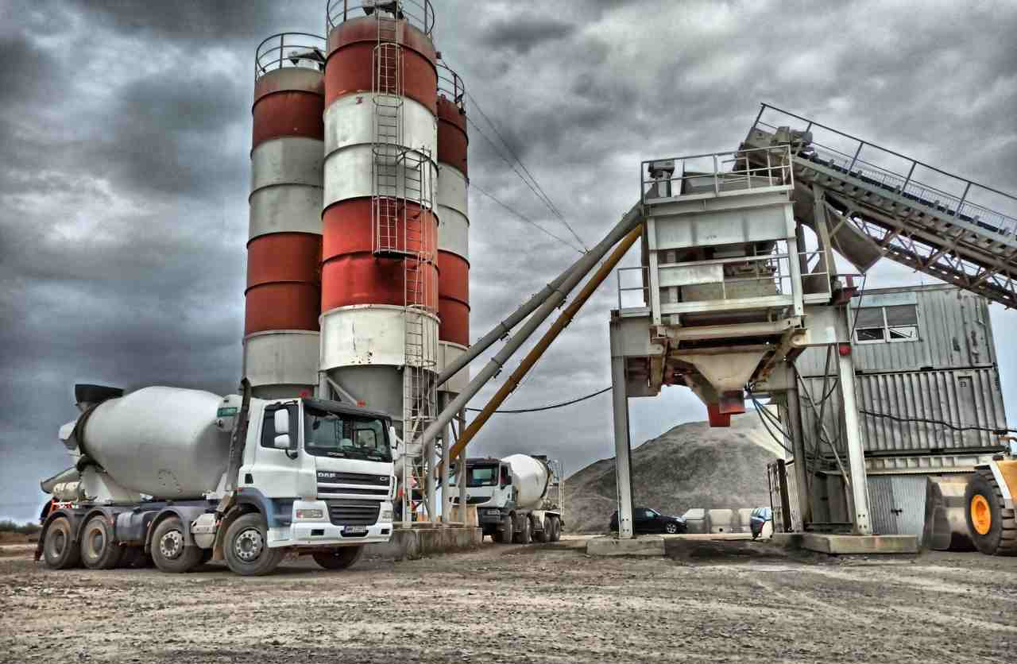
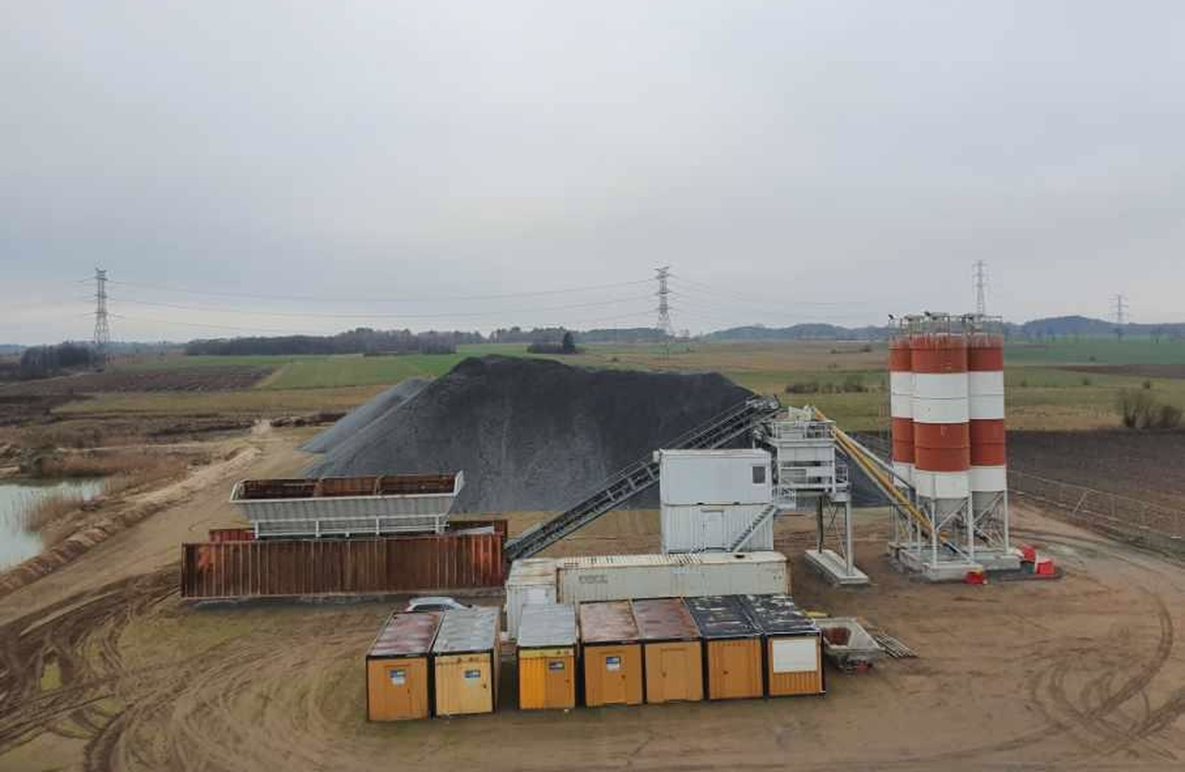
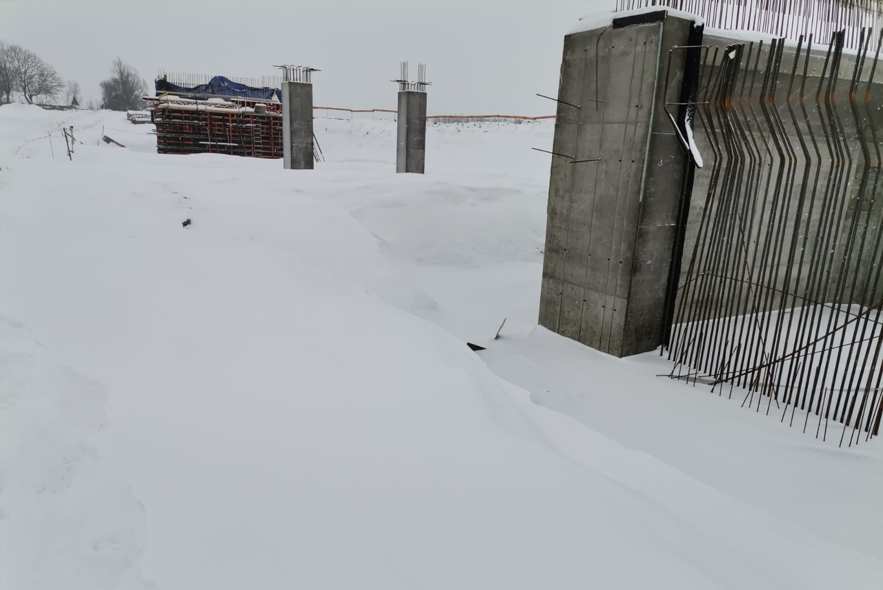
Conpol sp. z o.o. – our projects
Construction of the Maintenance Circuit of the Jawor Road at S3 along with the bridge structures
Project and construction of the Szczecinek bypass along the national road No. 11
Construction of bridge structures and production of concrete at the construction of the S61 Via Baltica expressway running from Warsaw to Tallinn in Estonia
The above is to show only some of the numerous ventures undertaken by RESBUD, Energokomplekt, Conpol and Uniwersim
RESBUD SE – we build to connect people

Slide 15
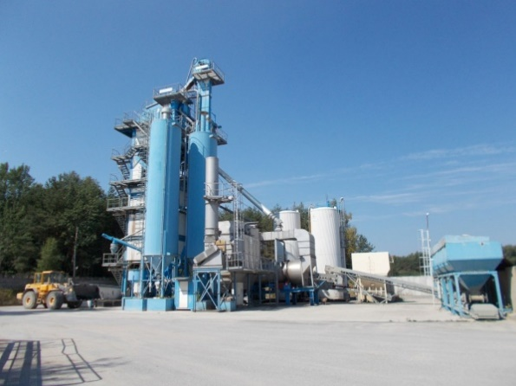
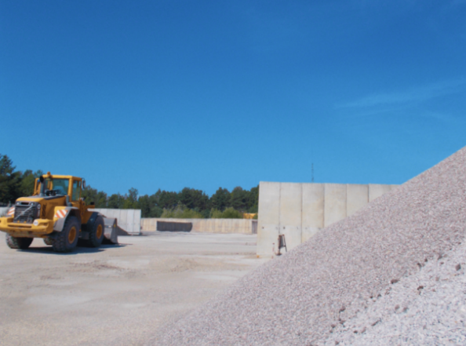
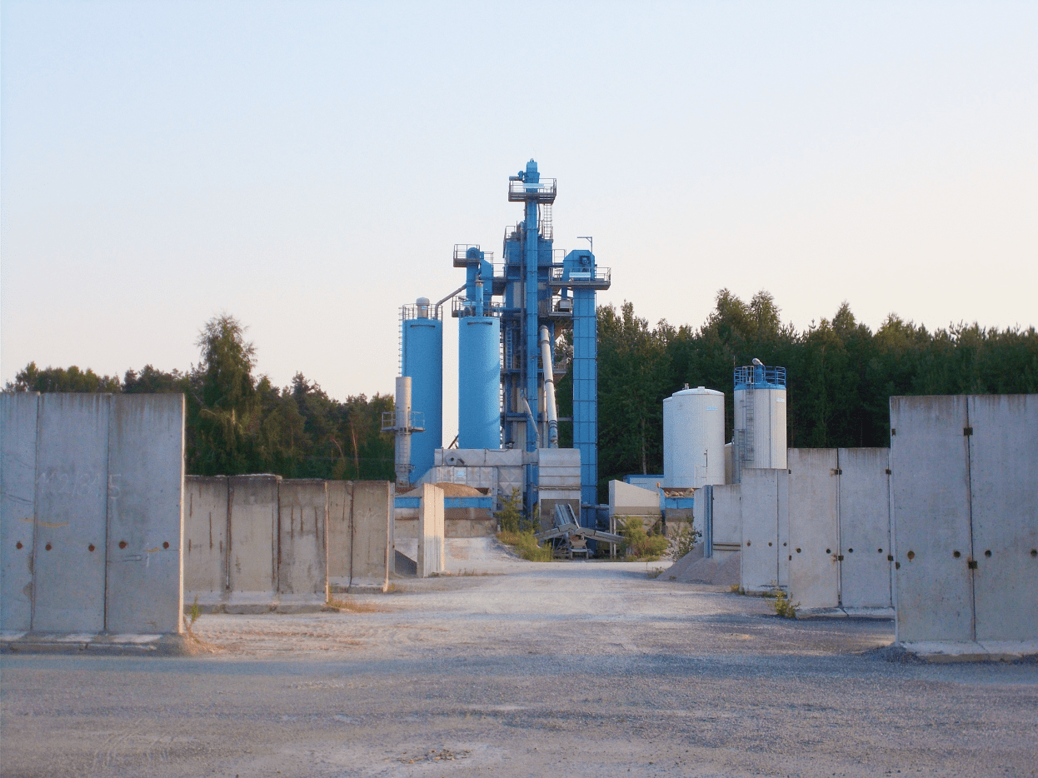
Our companies
UNIWERSIM:
manufactures asphalt mixtures intended for the performance of all structural layers of pavements for roads of the traffic category from KR1 to KR7. Company’s key competitive advantage is a mobile concrete plant with very high performance and a team of highly qualified operators;
for many years has been cooperating with companies specializing in the modernization and reconstruction of local and provincial roads, as well as with companies implementing contracts for the construction of expressways and motorways;
takes care of contracts from the side of concrete production with the use of own or customer materials. It offers a wide range of concretes, taking into account the intended use of the material, construction method, environmental conditions, investment specification as well as individual customer preferences: for substructures, goods, construction and bridges. For the production of concrete, a modern BHS Duomix 250 type mobile concrete batching plant is used, with a capacity of 220-250 m3 / h, depending on the type of concrete produced;
for the production of bituminous masses, it uses a fully automated installation of the BENNINGHOVEN TBA 160/240 OU brand with a mixing capacity of 160 t/h. The qualified FOREQ Laboratory controls the proper course of technological processes during the production of bituminous masses;
since 2015, it has had the Factory Control Certificate confirming the plant's ability to produce asphalt mixtures according to European standards PN-EN 13108-1.
www.uniwersim.pl
* Installation does not require special foundations and does not require any building permits.
RESBUD SE – we build to connect people

Slide 16
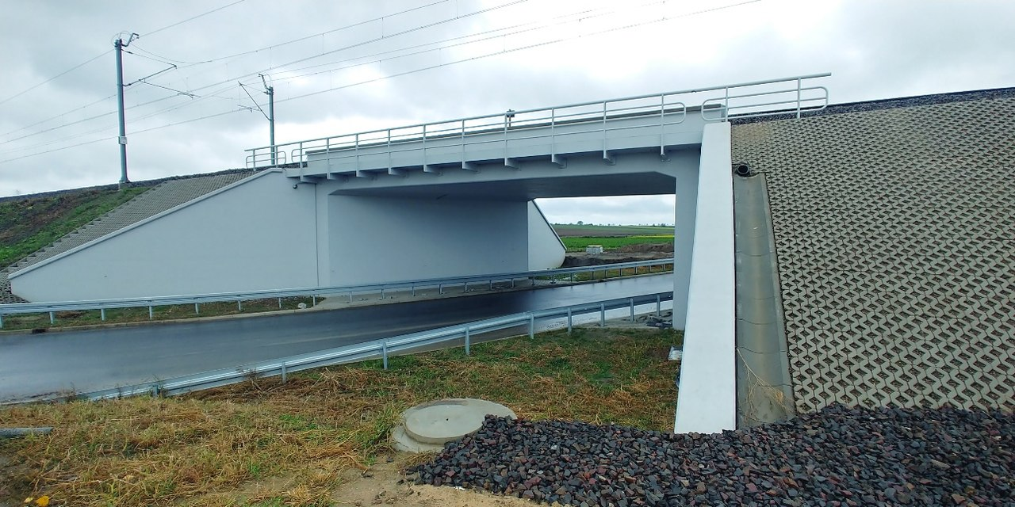
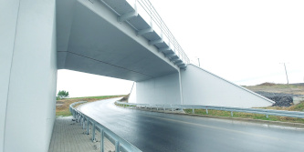
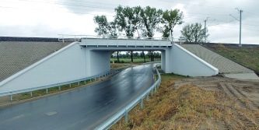
Uniwersim sp. z o.o. – our projects
UNIWERSIM was a producer of concrete and asphalt mixtures for Strabag S.A. for the expansion of the national road No. 8 to the parameters of the expressway on the Radziejowice-Przeszkoda section (in 2017-2019).
The above is to show only some of the numerous ventures undertaken by RESBUD, Energokomplekt, Conpol and Uniwersim
RESBUD SE – we build to connect people

Slide 17
Our partners
Siemens AG
Trench France SAS
Korporacyjne Centrum Badawcze ABB Oddział w Szwecji
Yokogawa Electric Corporation
Ust-Kamenogorsk Condenser Plant (Kazachstan)
Century Solarbright Industry Co. Ltd
BELOS-PLP S.A.
GIG (Estonia)
ZETKAMA (USA)
AVK (Dania)
Wilo SE
Beltelekabel (Białoruś)
JSC „Ural Power Engineering Construction Company”
JSC Jelektrouralmontazh
JSC „TJeK Mosjenjergo”
LLC JeSK „Jenergomost”
LLC „Lenjelektromontazh”
Astaldi S P A S.A. Oddział w Polsce
Torpol S.A.
Grupa BERGER
Eurovia Polska S.A
Milimex
Grupa Unibep
Lafarge
PORR S.A.
Strabag SE
Przedsiębiorstwo Wielobranżowe Rydmar Ryszard Chłystek
Agro-Trans Skoneczny Ryszard
Grud-Trans s.c.
Lafarge
Budokrusz S.A.
Suwalskie Kopalnie Surowców Mineralnych
PKN ORLEN
Grupa LOTOS
RESBUD SE – we build to connect people

Slide 18
RESBUD SE
SHAREHOLDERS
MARCH 9, 2021
Shareholder | Number of shares | % share | Number of votes | % votes
Alexey Petrov* | 106 950 820 | 45,20 | 106 950 820 | 45,20
Olga Petrova, Sergey Petrov* | 46 852 324 | 19,80 | 46 852 324 | 19,80
Iwona Długosz* | 43 831 548 | 18,52 | 43 831 548 | 18,52
Others | 38 985 571 | 16,48 | 38 985 571 | 16,48
* with subsidiaries
RESBUD SE – we build to connect people

Slide 19
RESBUD SE
FINANCIAL DATA
2020 year
Company | Income | Net profit | Capital
RESBUD SE | 0 | - 347 000 EUR | 1 977 000 EUR
2020 year
Company | Income | Net profit | Capital
Energokomplekt OOO | 52 244 716 EUR | 1 771 286 EUR | 7 386 134 EUR
Conpol Sp. z o.o. | 752 638 EUR | 26 535 EUR | 1 254 615 EUR
Uniwersim Sp. z o.o. | 1 146 062 EUR | 106 361 EUR | 301 757 EUR
Since February 4, 2021 the company owns 100% shares in Uniwersim sp. z o.o., 100% shares in Conpol sp. z o.o. and 100% shares in Energokomplekt OOO (87.8% directly and 12.2% indirectly). As a result, RESBUD SE is obliged to prepare consolidated financial statements with the above-mentioned companies, starting from 2021.
RESBUD SE – we build to connect people

Slide 20
RESBUD SE
HOLDING RESBUD SE – PLANS FOR THE FUTURE
RESBUD SE plans to become a significant general contractor in Central and Eastern Europe in the field of construction, civil engineering and power network development, carrying out comprehensive infrastructure projects through subcontractors, which are part of the holding - Conpol Sp. z o.o., Uniwersim Sp. z o.o. and Energokomplekt OOO.
In the future, the holding is planning to expand the capital group with other companies from the same or related industries.
In the circle of interests of the Group is to create an activity connected with financing young companies and start-ups, giving an opportunity to achieve profits from the conducted activity.
RESBUD SE intends to implement innovative solutions in the industry in which it operates, thanks to the cooperation with prestigious technical universities from the countries where the holding companies operate.
RESBUD SE – we build to connect people

Slide 21
RESBUD SE
AREAS OF ACTIVITY OF RESBUD SE GROUP COMPANIES
Conpol Sp. z o.o. plans to increase the number and value of implemented contracts.
The company's experience in the implementation of engineering investments and cooperation with large entities operating in the engineering construction industry give real opportunities to increase the company's revenues at the level of several dozen percent annually over the next 3 years.
Uniwersim Sp. z o.o. despite the pandemic, doesn’t slow down in the construction, modernization and reconstruction of voivodeship roads.
In 2021, the municipalities adjacent to the company's production plant will allocate PLN 355 million for this purpose. Due to the close location of the production base, Uniwersim wants to actively participate in the implementation of these road investments.
Energokomplekt OOO, realizing the commitments already undertaken and contracts concluded, will achieve revenues approximately 20% higher in 2021 than in 2020.
RESBUD SE – we build to connect people

Slide 22
RESBUD SE
RESBUD SE – Management Board
Krzysztof Długosz - President of the Management Board
Appointed by the Supervisory Board of RESBUD SE as the President of the Management Board of the Company on April 24th, 2021.
Professional experience
Krzysztof Długosz has extensive experience in building the value and development of companies which he manages with a practical approach to challenges and issues. He initiated the establishment of engineering and construction companies, which today are part of the RESBUD SE holding: Conpol sp. z o.o. and Uniwersim sp. z o.o. He has been at the helm of the former since 2013 and is still a Management Board Members since 2014 in the latter.
He gained his profound professional experience thanks to many years of cooperation with international corporations and enterprises, including but not limited to the company, which has been a partner in the construction of a 220V power and transmission line, connecting the HV power station, the Komsomolskaya - Selikhino - Vanino line, commissioned by Ural Energy Company TGK-10.
Education
A graduate of a technical school with a specialization in control and measurement equipment and industrial automation.
Joanna Dyja - Member of Management Board
Appointed by the Supervisory Board of RESBUD SE to the Management Board of the Company on April 24th, 2021.
Professional experience
Joanna Dyja has been professionally associated with the banking and financial sector since 1992. In 2009-2019 she was the President of the Management Board of Amathus TFI S.A. - private investment fund company that manages assets with a total value of several hundred million PLN. In 2015-2018, she was the co-owner of Ventus sp. z o.o., which dealt with obtaining EU subsidies for energy-saving, pro-ecological or innovative projects. Before that, she worked in: Xelion Financial Advisors (2006-2009, as Team Leader), Deutsche Bank PBC (2003-2006, as Manager in the Sales Management Department), Deutsche Bank 24 (2001-2003, as Regional Director and Branch Director) and Bank Spółdzielnia Regionalna SA Kraków (1992-2001, including as Branch Director).
Education
A graduate of the University of Economics in Katowice (department of industry, majored in socioeconomics), the University of Economics in Krakow (School of Entrepreneurship and Management, postgraduate studies - banking) and the AGH University of Science and Technology in Krakow (Real estate appraisal - postgraduate studies).
RESBUD SE – we build to connect people

Slide 23
Contact us!
Head office
Järvevana tee 9-40, 11314 Tallinn, Estonia
TIN / Ariregister nr 14617750
VAT: EE102234350
e-mail: resbud@resbud.ee
phone number: +372 602 7780
Office in Poland
Zielna 20, 32-085
Modlniczka near Cracow
NIP: 1060007584
e-mail: resbud@resbud.ee
phone number: +48 12 307 15 99

